Slide 1
ORGANISATIONAL
BEHAVIOUR
CHAPTER-13
TEAM DYNAMICS

Slide 2
LEARNING OBJECTIVES
1. Groups and teams are common in organizations and the latter are gradually replacing the former.
2. A team is a group of small number of people with complementary skills and committed to a common purpose.
3. Teams offer several benefits to organizations, major advantages being enhanced performance and increased quality.
4. As in groups, teams are also of different types. There are work teams, virtual teams, problem solving teams and the like.
5. Teams formation passes through different stages. Starting from planning, a team proceeds through several phases and reaches the final one.
6. Teams can be made more effective provided there is cooperation and trust.
7. Quality circles and self-managed teams are typical teams found in organizations.
8. Key terms given at the end of the chapter.

Slide 3
Features of Teams
        They are empowered to share various management and leadership functions.
        They plan, control and improve their own work processes.
        They set their own goals and inspect their own work.
        They often create their own schedules and review their performance as a group.
        They may prepare their own budgets and coordinate their work with other departments.
        They usually order materials, keep inventories and deal with suppliers.
        They are frequently responsible for acquiring any new training they might need.
        They may hire their own replacement or assume responsibility for disciplining their own members.
        They, and not others outside the team, take responsibility for the quality of their products or services.

Slide 4
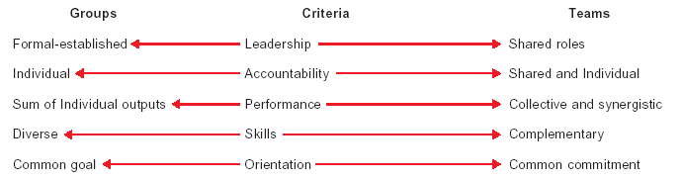
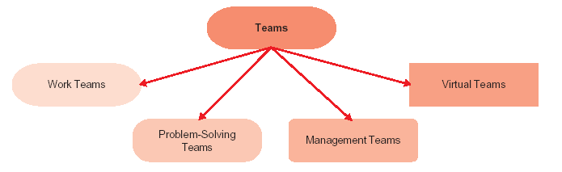
Differences Between Groups and Teams
Types of Teams

Slide 5
Guidelines to Enhance Team Performance
Have a small team – membership not to exceed 12.
Take care to ensure that teams comprise members with atleast three types of skill : technical skills, problem – solving and decision – making skills, and interpersonal skills.
Let the teams have specific goals and develop commitment to realize the goals.
Have proper leadership and structure for teams. Leadership and structure provide focus and direction.
Don’t allow members to hide inside a group and indulge in social loafing.
Establish appropriate performance evaluation and suitable rewards system.
Ensure the team members develop high mutual trust. High performance teams are characterized by high mutual trust.
Establish demanding performance standards and provide direction.
Create a sense of urgency in the first meeting.
Set clear rules of behaviour.
Regularly challenge the team with new projects or problems to solve.

Slide 6
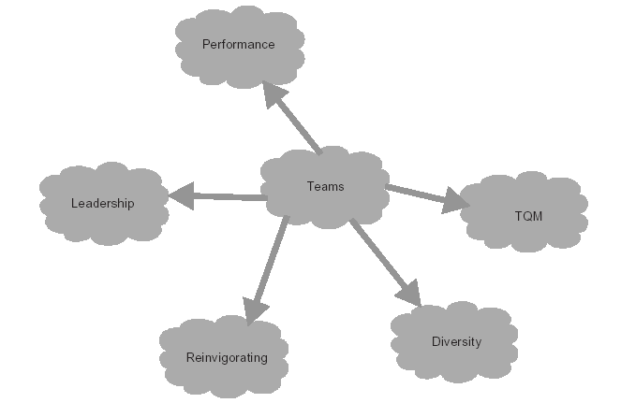
Team Issues

Slide 7
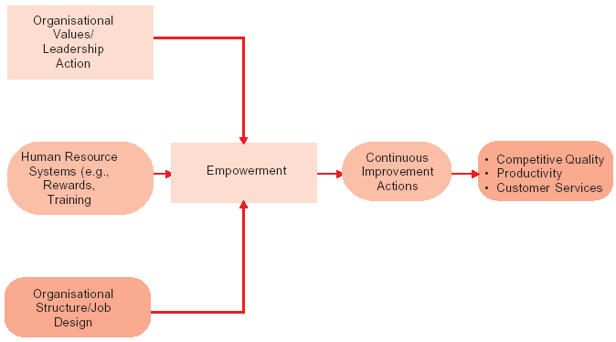
Facilitators of Empowered Teams

Slide 8
Key Terms
Teams
TQM
Empowered team
Virtual team
Quality circle

